Slide 1
PhoneGap and Visual Studio
Jamie Colley
www.DotNetGeekette.com
@DotNetGeekette

Slide 2
What is PhoneGap?
PhoneGap is an open source framework for creating mobile apps using a single codebase that can deploy across the major mobile platforms.
Notes:
PhoneGap is an open source framework for creating mobile apps using a single codebase that can deploy across the major mobile platforms – iOS, Android, Windows Phone, Blackberry, and webOS.
There are multiple frameworks for creating cross-platform mobile applications, including Xamarin and app Mobi, so what makes PhoneGap different? For one, the technologies are different. Consider the major mobile platforms.

Slide 3

The Common Element
Notes:
While they seemingly have little in common from a programmatic standpoint in that they all use their own languages and SDKs, the one piece they all share a browser that adheres to the same standards.
PhoneGap takes advantage of this commonality and allows you to create natively installed mobile apps that basically run in a chromeless web browser. This means that you can leverage the web development skills you have and write apps for all of the major mobile platforms using HTML, Javascript, and CSS.

Slide 4
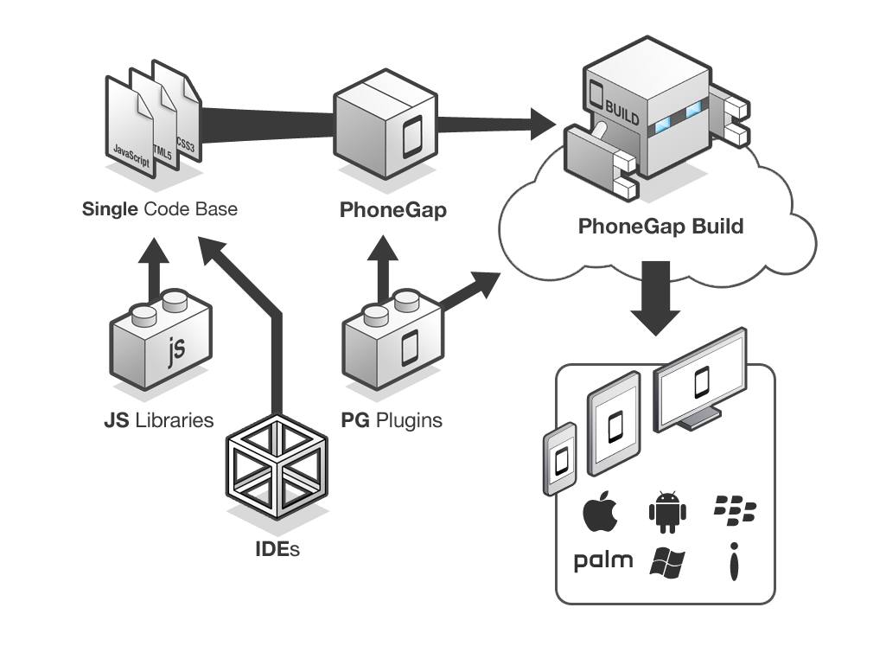
PhoneGap Overview
Notes:
Essentially, this is what the PhoneGap application creation process looks like. You take your IDE of choice as well as the javascript libraries you know and love, like jQuery mobile. You create one codebase, thereby eliminating the maintenance nightmares we face with redundant codebases. You wrap your html, css, and javascript files with PhoneGap, and you can take advantage of the PhoneGap plugins that interact with your device’s capabilities, like the camera and geolocation services. You send your app to PhoneGap build, and you end up with ready-to-submit app packages for each of the target platforms.

Slide 5
Let’s Create an App!
Notes:
Once you’re ready to get started, it’s very easy to begin development on a PhoneGap app.

Slide 6
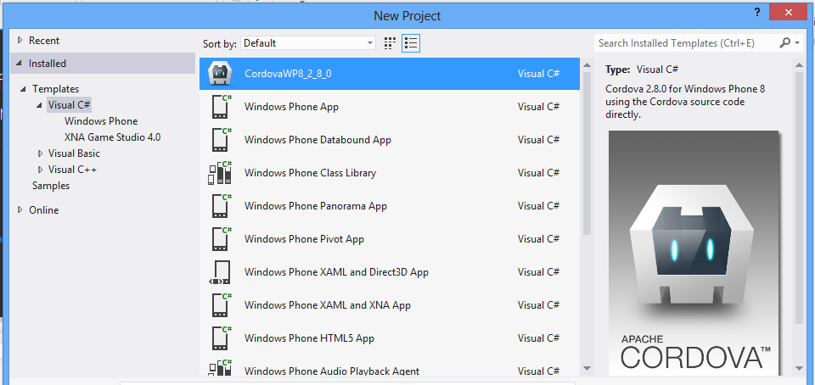
Getting Started in Visual Studio
Notes:
The prerequisite to all of this is, of course, the Windows Phone SDK and the latest copy of PhoneGap extracted to some location on your machine.
In the lib directory of the PhoneGap download is a Visual Studio template file, which you will copy into your Visual Studio project templates folder.
When you create a new project in Visual Studio, you’ll then see your Apache Cordova template, you’ll select that, and you will then be able to begin your development.

Slide 7
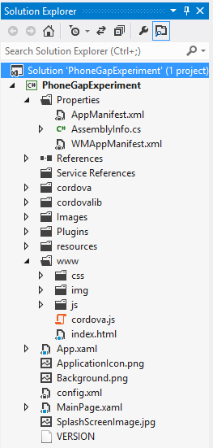
What’s Inside
Accelerometer
Camera
Capture
Compass
Collection
Contacts
Device
Events
File
Geolocation
Globalization
InAppBrowser
Media
Notification
Splashscreen
Storage
Notes:
Once you’ve created your project, you’ll see three key areas of note.
First we have the www folder, which contains all of the html, javascript, and css for the app. It also contains the cordova.js file, which contains the necessary javascript to launch your app.
You’ll also see that you have the same manifest files you have when you’re developing specifically for Windows Phone. When you go to build your app for multiple platforms, the information in this manifest will be used in the packaging information for other platforms as well.
Finally, you’ll see a list of plugins. These give you the ability to do things like interact with your device’s camera or contact list, launch another web browser, set up app notifications, and do the same kinds of things you could do if you were developing for a particular mobile device. The nice thing here is that you don’t have to maintain that device-specific functionality yourself, and you can use what’s already in the box. While the files in this solution are written in C#, you’ll be writing API calls in your javascript to take advantage of this functionality on each platform.

Slide 8
Testing
Notes:
Once you’ve written your app, you obviously want to test it. There are several different ways to test a PhoneGap app depending on which part of the testing process you’re at.

Slide 9
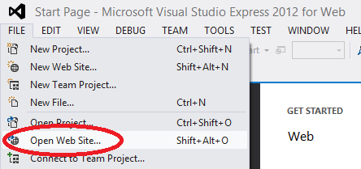
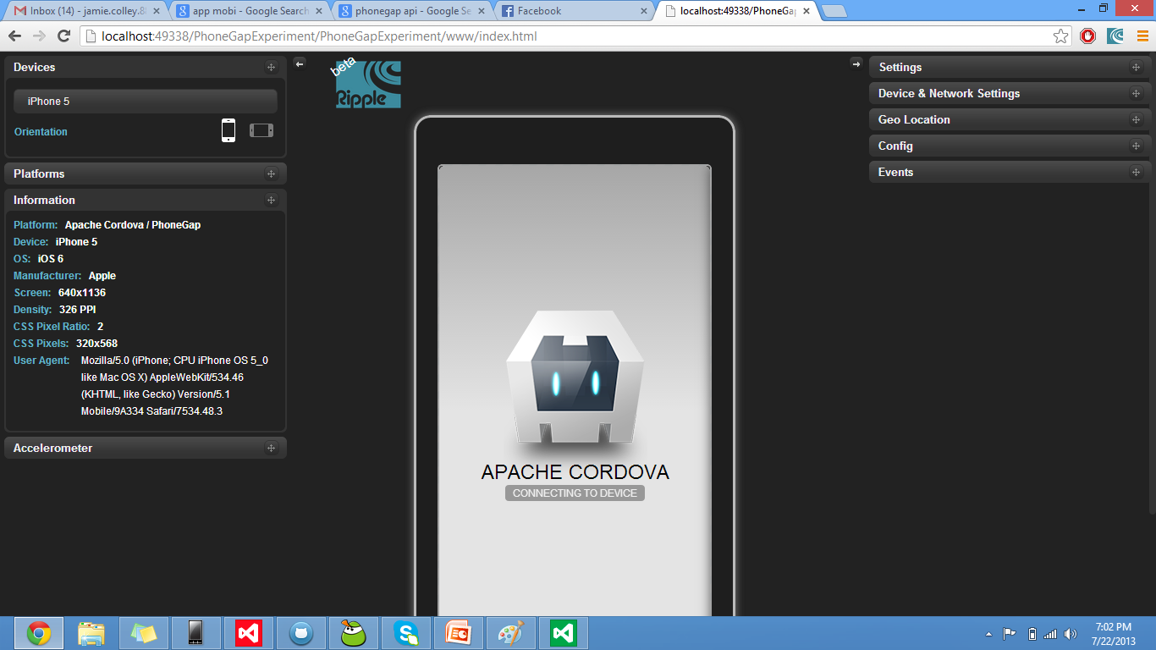
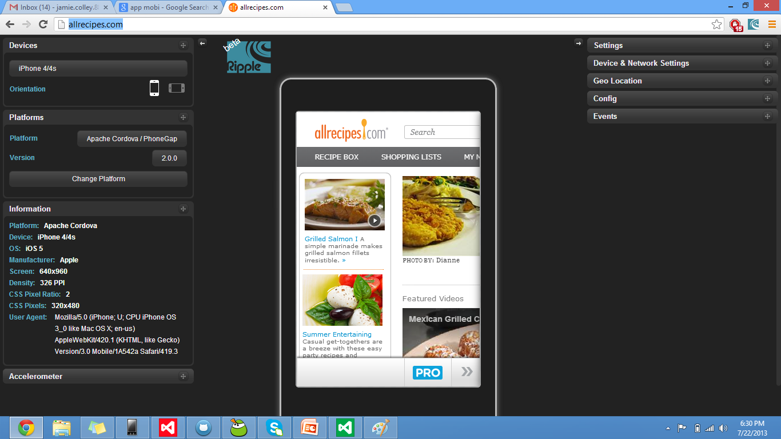
Testing your App
Notes:
When I’m developing for the web, for me, Chrome developer tools are second to none. So yes, while there are ways to debug Javascript in Visual Studio, I typically choose not to, and in my experiments with PhoneGap, I also chose to pursue an alternative route.
Fortunately, there’s a Chrome extension called the Ripple Emulator. The idea is that you can get a sense for how your app will look on different screen sizes, and you have the added benefit of being able to use Chrome’s Javascript debugging tools.
With the Ripple Emulator, you can view any website or any app, provided that it has been deployed to a URL your computer can reach. In Visual Studio, I can open my solution as a web site, run that locally using Chrome, and enable Ripple.
One caveat with the Ripple Emulator – it really should be used only to debug Javascript. While you’ll see your app in what looks like an iPhone 4, the emulator unapologetically doesn’t render your app the same way an iPhone would. As always, before deploying your app to an app store, you’ll want to test it on an actual device.

Slide 10
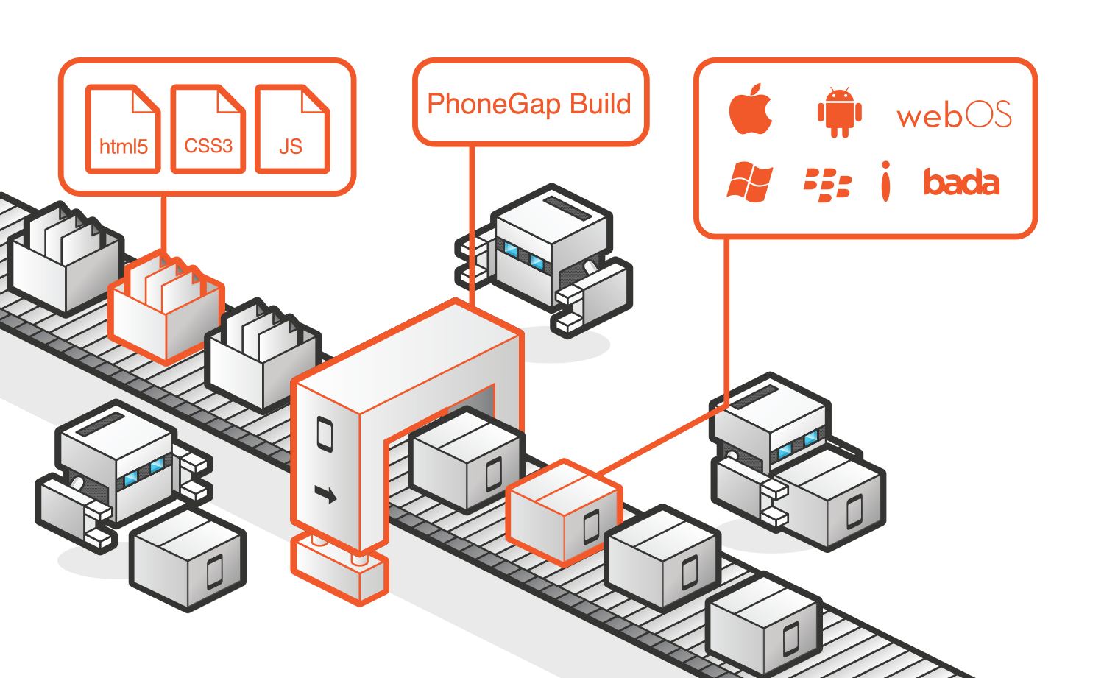
PhoneGap Build
Notes:
Once you get to do that, it’s really easy to do so. First, you’ll need to build your app on build.phonegap.com.
The Adobe PhoneGap Build process is as simple as it looks here. You connect to a GitHub repository (or upload a zip file), have PhoneGap build your app in the cloud, and you end up with the appropriate packages to submit to the iOS, Windows Phone, Android, and Blackberry stores. If you’re missing any requirements for these platforms, you’ll be notified right on the PhoneGap site, and you can fix the issues there.
To test the resulting packages on a device, using your phone’s web browser, navigate to the build page and click “Install App.”
Once you’re satisfied with your app, all that’s left for you to do is to submit the packages to the app stores of your choice.
As you can see, developing a PhoneGap app is very simple. The development process itself is exactly the same as if you were creating a website, and the only major difference is the PhoneGap build process. Sure, you still have to test on many different devices just as if you would had you been testing browser compatibility for a website.
The advantage to using PhoneGap is that you get to use the skills you already have and the languages you already know. You don’t need to have multiple codebases that accomplish the same thing, and when you need to make a change or an update, you don’t have to manually add that change to each platform-specific projects.
One of the main criticisms of PhoneGap is that with one UI layer for all mobile platforms, you’re not truly adhering to the design principles of any of them. It really comes down to what you’re trying to accomplish. If you have a very limited budget and you need to get something out the door quickly, PhoneGap is definitely a good candidate for you our your business. The same goes for if you just want to get something out the door so you can get feedback on it before you begin to invest the time and money into another cross-platform mobile app development framework, then PhoneGap can certainly be that kind of stop gap solution for you.

Slide 11
Jamie Colley
@DotNetGeekette
jamie@dotnetgeekette.com
www.DotNetGeekette.com
Notes:
That right there is a very birds-eye view of PhoneGap. As this is a lightning talk and I want to be respectful of everyone’s time, if you have any questions or would like to talk further, please see me afterwards. I’ll be sure to tweet out a link to my slides, so if you’re interested, follow me on Twitter at DotNetGeekette.
Thank you.

Slide 12
Image Attribution
Diagram - PhoneGap Overview by Adobe / Yohei Shimomae
Diagram - PhoneGap Build by Adobe / Yohei Shimomae
Smart Phone, Tablet, and PC – The Droid Guy

